Slide 1


Slide 2









VISION
Vision and Mission
MISSION
To provide exceptional value to our customers by designing and implementing high quality seamless solutions that best fit their complex supply chain needs and give them a competitive advantage.
We want to be known for our innovative and integrated supply chain solutions that leverage technology and deliver on our commitment every time.
BEST FIT SOLUTIONS FOR ALL YOUR SUPPLY CHAIN NEEDS

Slide 3

Our Capabilities
23 North is at the cross-section of several growth drivers

Slide 4



Services We Offered
01. Warehousing
Multi‐user facilities
Storage Solutions
Handling Solutions
WMS
Last mile deliveries
Returns Management
Value Added Services
KPI/SLA adherence
Warehousing
In-plant Logistics Sol.
02. In-Plant logistics SolUTIONS
Plant stores management
Vendor call‐outs
IQC & Line feeding
Material handling
Trained manpower and PPE
End of line packaging
Dispatch coordination
Returns management
Transportation
03. Transportation
Dedicated vehicles
FTL
PTL/LTL
Reverse logistics
TMS
KPI/SLA Management
23 North is at the cross-section of several growth drivers

Slide 5








Our Industrial Expertise
Oil Gas
Pharma
CDIT
FMCG
"Excelling in our industries through deep knowledge and hands-on experience, delivering impactful results for our clients."
Chemicals
E-Commerce
Automotive
& Aviation
Retail Fashion & Life style

Slide 6
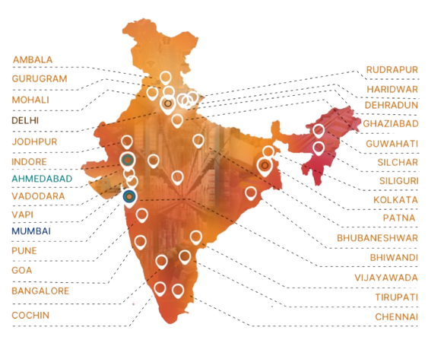
Our Presence
"As a company, we are dedicated to continuous growth and improvement through hard work and a commitment to excellence."
1
million Sq. Ft footprint
5
(R.O)
million+ shipment handled
(R.O)
50
(R.O)
+ TPT Branches
(C.O)
1000
+
workforce
Commitment to excellence

Slide 7
Organization Structure
Board Of Directors
COO
HR
Transportation
Contract Logistics
Finance
IT
RM - East
Sales Head
RM - West
KAM
Solution Design
Operations
RM - North
RM - East
RM - East
RM - South
RM - West
RM - West
RM - North
RM - North
RM - South
RM - South

Slide 8


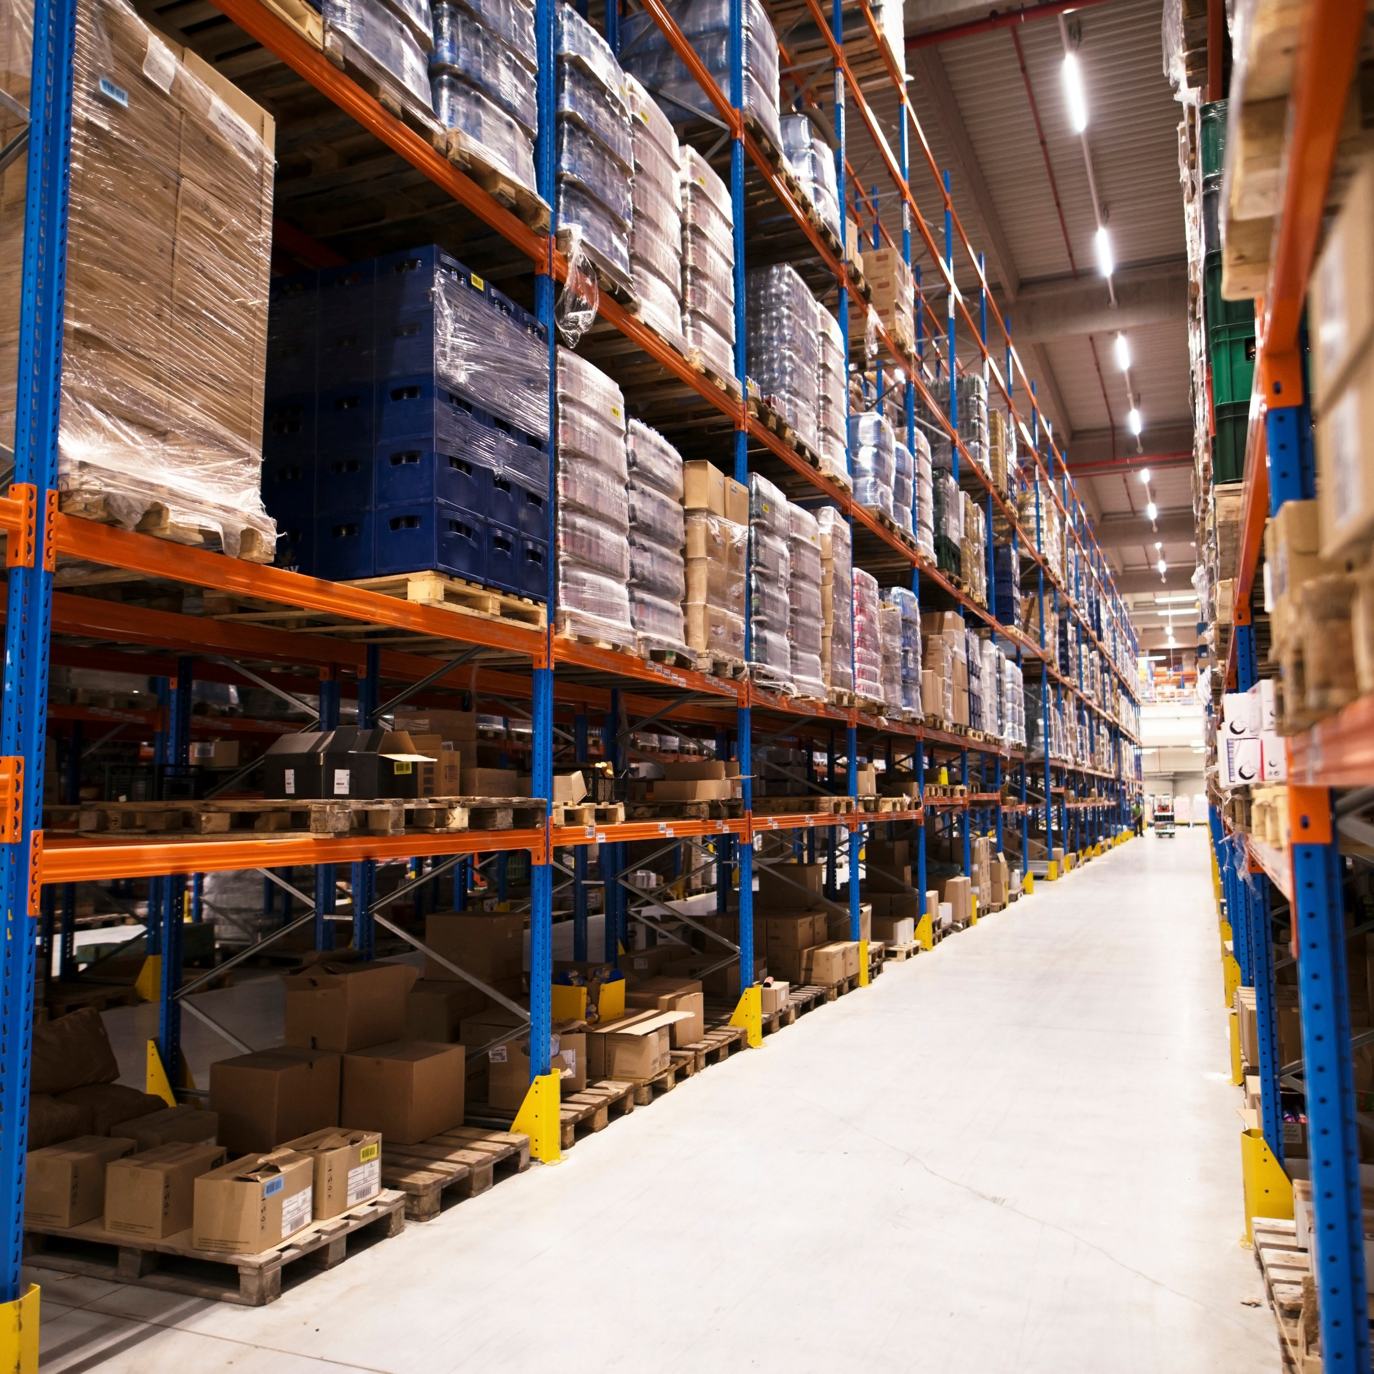




Technology
Inventory Management
Receiving & Put Away
Our expertise in warehouse management systems, we offer clients efficient and accurate inventory mgmt. that enhances productivity & reduces costs."
"Through our receiving and put away management expertise, integrated with wms, we ensure efficient, accurate, and optimized inventory management for our clients.".
Reporting Management
WMS
Capable of EDI stroke API Integration
Wi-fi & Barcode System
"Our reporting management expertise, combined with the power of warehouse management systems, provides clients with in-depth insights and analysis for informed decision-making.".
Expert in optimizing warehouse efficiency through WiFi network implementation and barcode technology integration.
Location Management
"Our location management expertise, combined with the efficiency of warehouse management systems, optimizes warehouse space utilization and reduces handling costs for our clients.".
Picking And Packing
"Our proficiency in picking and packing management, supported by WMS, ensures timely and accurate order fulfillment for our clients."
Intelligent & Adaptive Business Processes

Slide 9
Past Experience:
(Similar domain Major Deliverables)
23 North is at the cross-section of several growth drivers

Slide 10
KPI Delivered: Apr 23 till Feb24
 | Weightage % | Apr-23 | May-23 | Jun-23 | Jul-23 | Aug-23 | Sep-23 | Oct-23 | Nov-23 | Dec-23 | Jan-24 | Feb-24
Inventory | 10% | 100.00% | 100.00% | 100.00% | 100.00% | 100.00% | 100.00% | 100.00% | 100.00% | 100.00% | 100.00% | 100.00%
Receiving | 15% | 97.33% | 98.00% | 98.00% | 100.00% | 100.00% | 99.00% | 99.00% | 100.00% | 100.00% | 100.00% | 100.00%
Dispatch | 30% | 100.00% | 100.00% | 100.00% | 100.00% | 100.00% | 100.00% | 100.00% | 100.00% | 100.00% | 100.00% | 100.00%
 | 20% | 100.00% | 100.00% | 100.00% | 100.00% | 100.00% | 100.00% | 100.00% | 100.00% | 100.00% | 100.00% | 100.00%
Transportation | 10% | 100.00% | 100.00% | 100.00% | 100.00% | 100.00% | 100.00% | 100.00% | 95.00% | 95.00% | 100.00% | 100.00%
Customer Service | 5% | 90.00% | 90.00% | 90.00% | 90.00% | 90.00% | 90.00% | 90.00% | 100.00% | 100.00% | 90.00% | 100.00%
Attendance | 10% | 100.00% | 100.00% | 100.00% | 100.00% | 100.00% | 100.00% | 100.00% | 100.00% | 100.00% | 100.00% | 90.00%
Total Weightage | 100% | 98% | 98% | 98% | 99% | 99% | 98% | 98% | 99% | 99% | 99% | 99%

Slide 11
Productivity: YoY
Improvement Project Initiatives
Order Time Processing
Put Away Zone
Location Consolidation
Total Nos Of Handler | No of Person
2022 (Previous LSP) | 14
2023 (23 North Solution Pvt Ltd) | 14
Average Per Month(Box Level) | No of Boxes Inbound | No of Boxes Outbound | Total
2022 | 8820 | 8883 | 17703
2023 | 11579 | 11305 | 22885
Average Per Month(Volume) in Lakhs | No of Qty Inbound( | No of Qty Outbound | Total
2022 | 54.02 | 52.01 | 106.03
2023 | 80.45 | 78.57 | 159.02
Productivity Improvement (Box Level) | 29%
Productivity Improvement (Volume) | 33%

Slide 12
Reports: Daily
Type of Report | Frequency | System/Manual | Type
Inward Report | Daily | Manual | DMMR (Daily Material Receiving Report)
Quality Assurance | Daily | Manual | Material Checklist
Warehouse Tracker | Weekly | Manual | Picking & Dispatch Report
Stock in Hand | Monthly | System | T Code MB52
In & Out Transaction Report | Monthly | System | T Code MB5B
Inward Report | Monthly | System | T Code MB51
Outward Report | Monthly | System | T Code VLO2N
Cargo Report | Monthly | Manual | Dispatched Report
OTIF | Monthly | Manual | STO Picking Report

Slide 13
Goals/Plan for AI
23 North is at the cross-section of several growth drivers

Slide 14
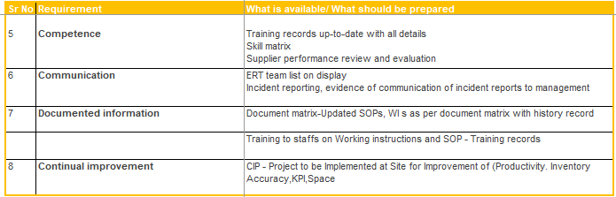

Slide 15
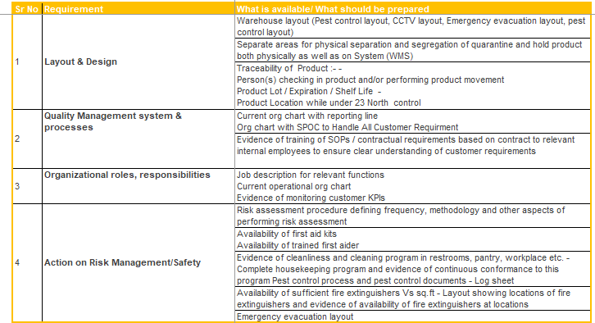

Slide 16
Project Implementation Life Cycle- End to End
Signing Of LOI
1
.
Assigning project manager
Both 23 North & PI will assign project manager.
Both project manager will act as POC
2
Understanding the current process
3
PI will be responsible for training & understanding of 23 North project manager .
New manpower hiring
23 North will hire as per the inputs of project manager.
4
Training of new joinees
5
PI will be responsible for the training of new joinees.
Manpower operations overlapping (N+47)
New joinees will work with current manpower to get the better understanding and handon experience.
6

Slide 17
Continued….
Transfer of IT assets
7
After the complision of M.P hiring, training & operation overlapping period, PI need to transfer all required IT assets. Computer systems, SAP log in
Transfer of MHE
PI will transfer all the MHE to 23 North after the inspection of MHE by 23 North project manager
8
Employees handover
9
All trained new joinees will take the handover of operations.
Inventory handover
Inventory handover will be done only after first wall to wall inventory is done, which will be after one quarter of running operations to get better understanding of parts. During inventory there will be no inventory transactions.
10

Slide 18
WMS Implementation: Key benefits to achieve
Improved Inventory Accuracy
Enhanced Order Fulfilment
Optimized Space Utilization
Real Time Visibility
Accurate Reporting
Scalability

Slide 19
WMS Implementation: Phase manner Strategy
Offline:
Integration
EDI
API
Timeline: 1-4 Weeks (Straight Fit)
Timeline: 4-12 Weeks (Any customization/Automation- Budgeting/Solution)
Implementation: required collobration between partners

Slide 20
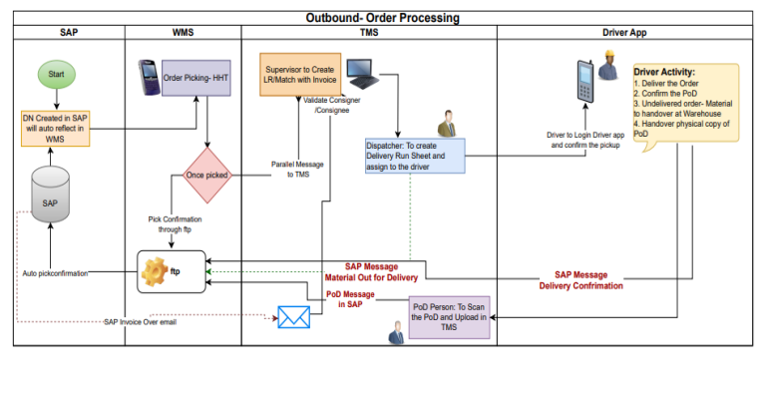
WMS Integration: with SAP customer’s Implemented
workflow

Slide 21
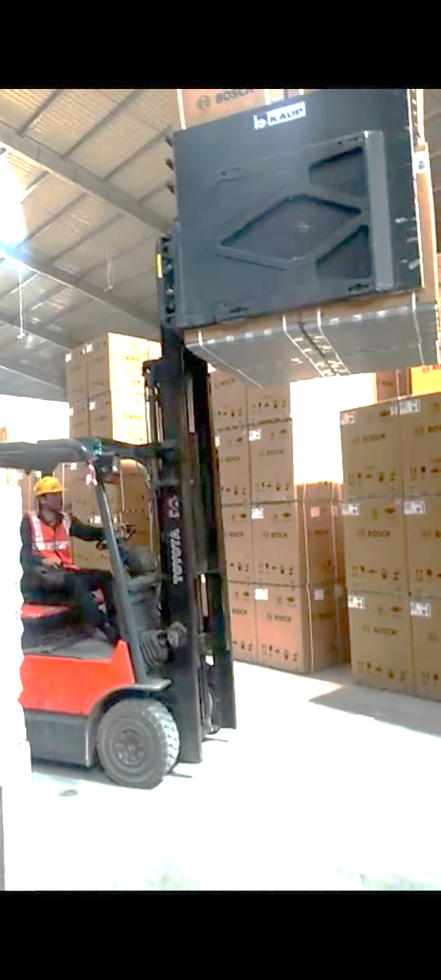
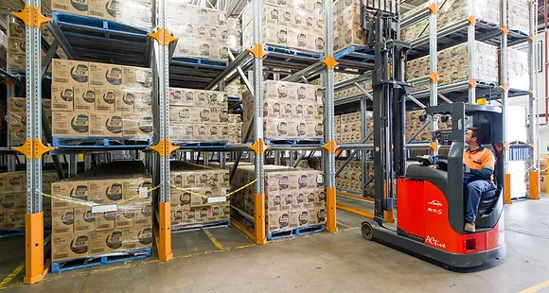
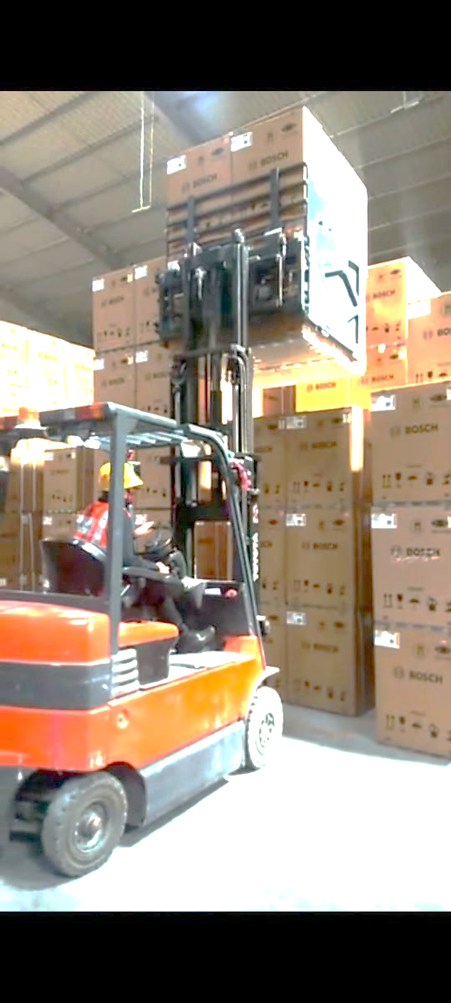
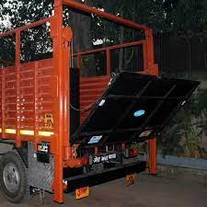
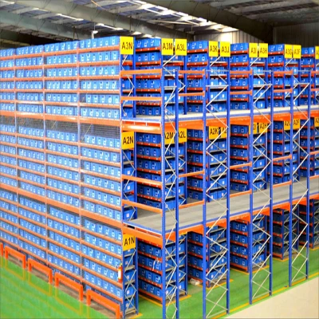
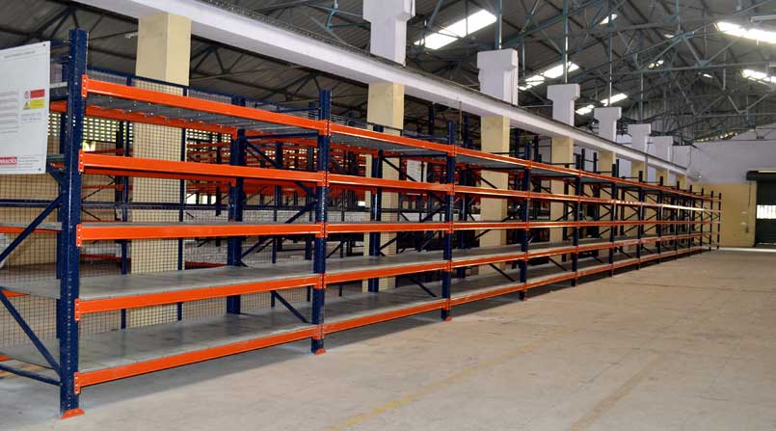
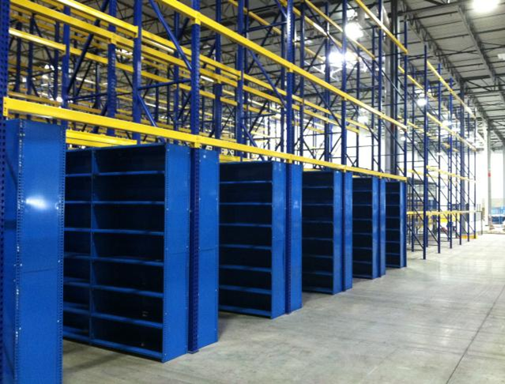
Systemizing Outcome: Storage & Visibility
State of the art complaint infrastructures to cope with challenges

Slide 22
Benefit for Vertical Storage
Optimizing space utilization in warehousing is crucial for maximizing storage capacity and improving operational efficiency
We employ unique approaches at vertical storage through racks & shelving storage solutions that can make the most of the warehouse space
Embracing innovative technologies like our flexible WMS system and considering alternative vertical storage configurations can lead to significant improvements in storage density, inventory visibility & traceability and overall productivity
We expect an improvement of 25% to 30% in the Space Utilization Factor with these storage best practices
We will support your business to adapt and implement these strategies to remain ahead of the competition and meet the growing demands of your customers.
Enhanced Order Fulfilment
Optimized Space Utilization
Real Time Visibility
Accurate Reporting
Scalability

Slide 23






























Our Key Customers

Slide 24

Thank You!
Corporate Office :United Business Park,
Unit no. 601 & 602,6th Floor, Plot A 40,
Road No. 11, Behind Old Passport Office. MIDC, Wagle Estate, Thane (West) - 400604 Maharashtra

